Slide 1
CAPSTONE PROJECT
Transport Demand
Prediction
INDIVIDUAL:-
ANKUR VISHWAKARMA

Slide 2

CAPSTONE PROJECT Transporation Demand Prediction

Slide 3
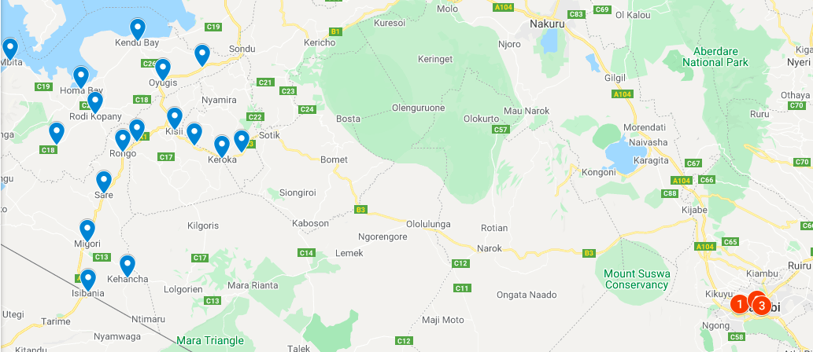
Map of Nairobi

Slide 4

Content
Problem Statement
Business understanding
Data Summary
Feature summary
Ride Origination Towns
Car type analyse
Travel time
Month wise booking trends
Hourly Travel Trend
Checking Outliers
Feature Engineering
ML Models and Metrics
Challenges
Conclusion

Slide 5
PROBLEM DESCRIPTION
This challenge asks you to build a model that predicts the number of seats that Mobiticket can expect to sell for each ride, i.e. for a specific route on a specific date and time. There are 14 routes in this dataset. All of the routes end in Nairobi and originate in towns to the North-West of Nairobi towards Lake Victoria.

Slide 6
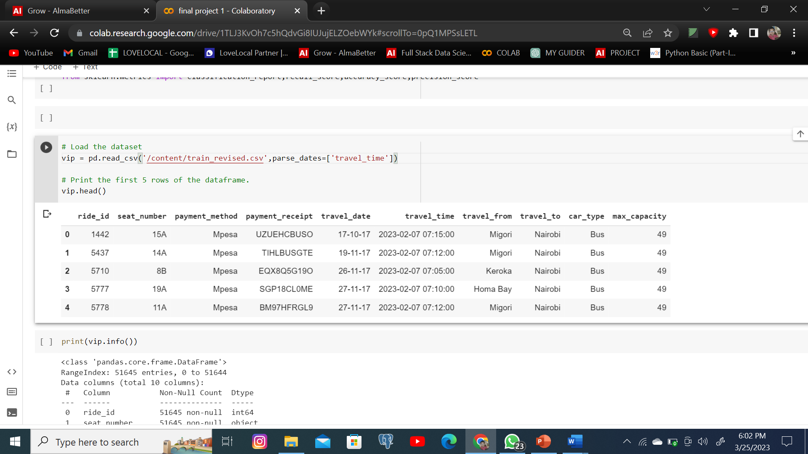
DATA SUMMARY
▪ This Dataset contain 51645 rows and 10 columns.
▪ 5 categorical features ‘payment_method ’, ‘payment_Receipt’,
& ‘travel_from and travel_to , car_type are given’.
Ride _id , seat_number , travel_Date , travel_time,max_capacity are numerical features.

Slide 7
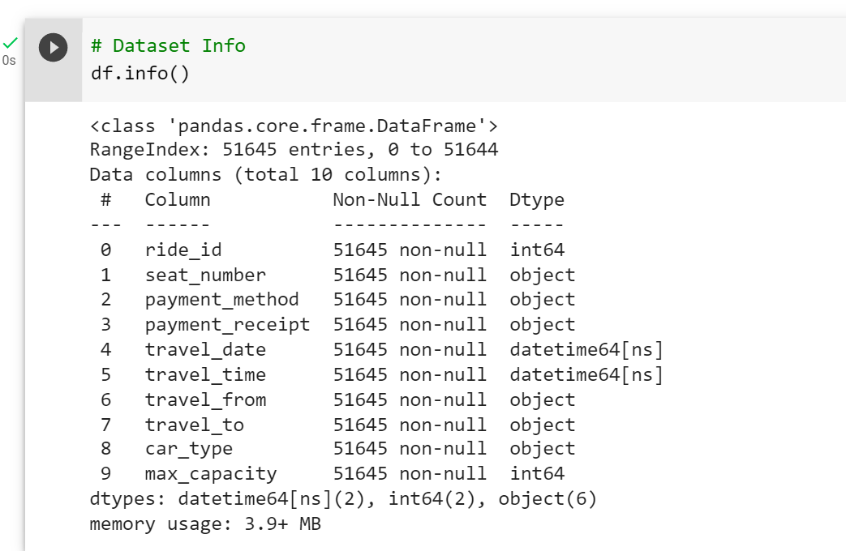
Data Information
▪ There are No Missing Values present
▪ There are No Duplicate values present
▪ There are No null values.
▪
All Features Are Independent Features we need to find our dependent features.

Slide 8
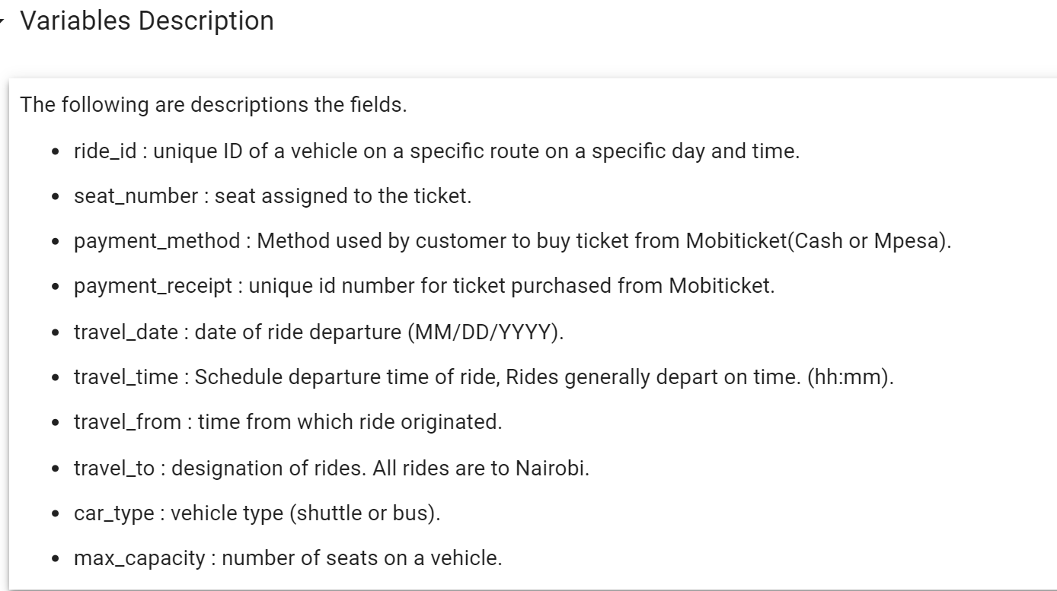
FEATURE SUMMARY

Slide 9
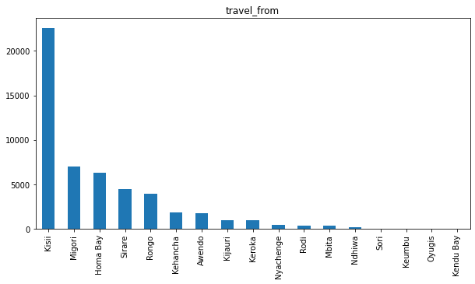
Ride Origination Towns
Kisii is the top place from where the most number of rides originate.

Slide 10
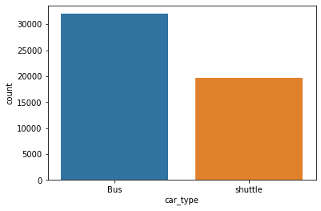
Car Type

Slide 11
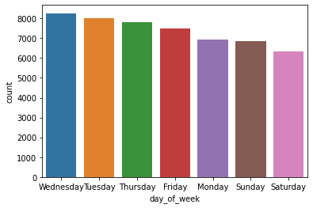
Which day is most busiest
Wednesday is the day where most of the booking occur and Saturday is the list booking no. of booking occur .where Monday and Sunday have the same number of booking.

Slide 12
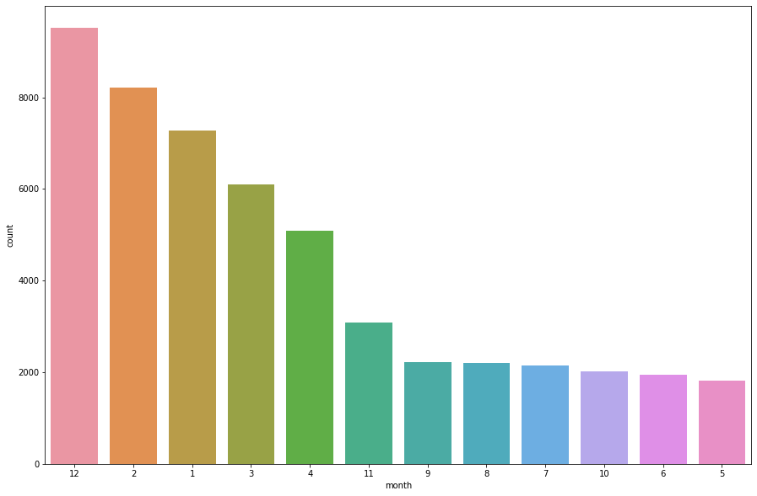
MONTH-WISE TREND .
DECEMBER MONTH HAVE HIGH NUMBER OF BOOKINGS AS COMPARED TO MAY TO OCTOMBER HAVE VERY LEAST NUMBER OF BOOKING AS COMPARED TO OTHER MONTH.

Slide 13
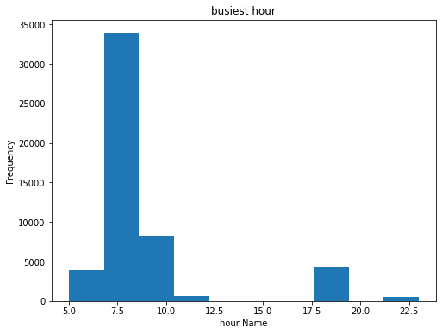
Hourly Trend.
Peak hours are 7.5 a.m to 8 a.m and least number of booking occur and 12.5 to 17.5 0 booking occurs .between afternoon to night it means return passanger not booking mobiticket.

Slide 14
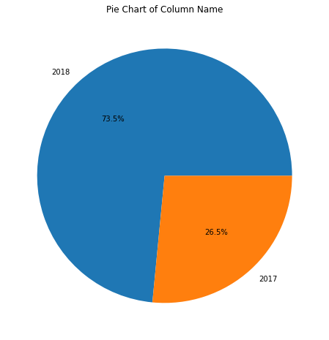
Growth by year
IN 2017 26.5% OF THE TOTAL BOOKING OCCUR FROM MOBIETICKET APP , WHERE IN 2018 IT GOES UPTO 73.5% ,WHICH MEANS THERE IS DRASTICALLY INCREASE BOOKING WITH THE YEAR.

Slide 15
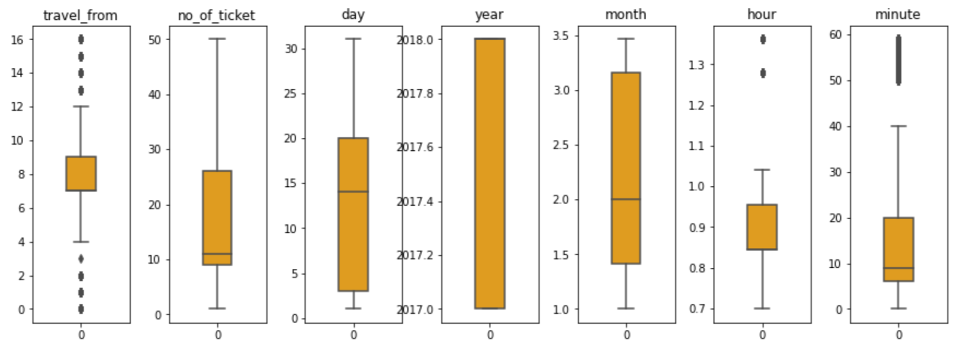
CHECKING OUTLIERS

Slide 16
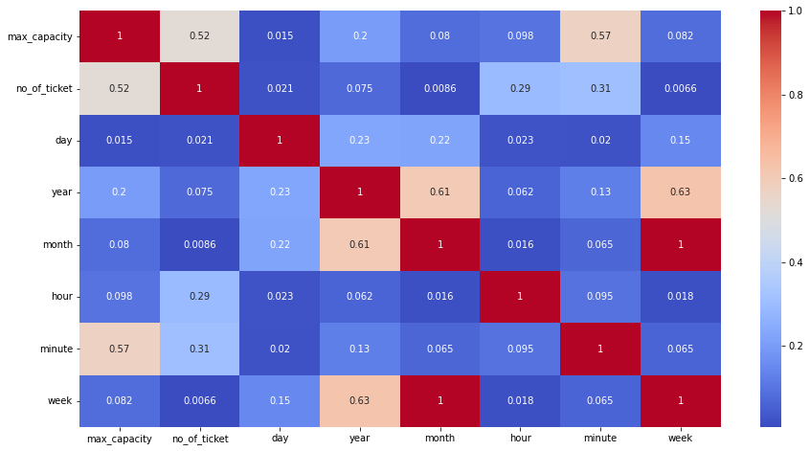
Correlation of Data

Slide 17
Machine learning algorithm
Linear regression
Xg boost regressor
Xg boost regressor with hyperparametric tuning
Random forest
Random forest with hyperparametric tuning

Slide 18
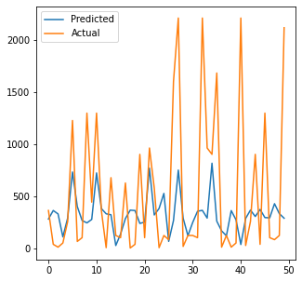
LINEAR REGRESSION
LINEAR REGRESSION MODEL SHOWING NOT GOOD ACCURACY , THAT WHY TRAINING SCORE AND TESTING SCORE SHOWING BELOW 20 ACCURACY . WE ARE GOING TO OUR NEXT MODEL BECAUSE LINEAR REGRESSION IS NOT GOOD FIT FOR THAT DATA.
training_score 0.15833194516930404 testing_score 0.15665535534223862

Slide 19
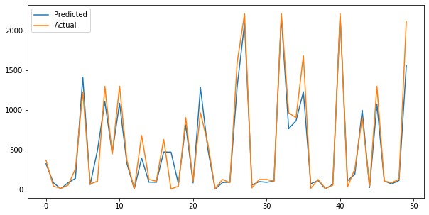
XG Boost Regressor
XG BOOST REGRESSOR MODEL SHOWING GOOD ACCURACY , THAT WHY TRAINING SCORE AND TESTING SCORE SHOWINGMORE THAN 90% ACCURACY . WE WILL XGBOOST REGRESSON WITH HYPERPARAMETRIC TUNING .
Train_Score : 0.9406665790756368
Test_score : 0.9323759449498852

Slide 20
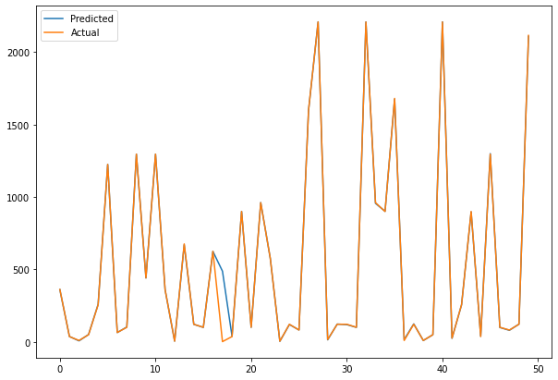
Xgboost Regressor with hyperparametric tuning
XG BOOST REGRESSOR MODEL SHOWING GOOD ACCURACY , THAT WHY TRAINING SCORE AND TESTING SCORE SHOWING MORE THAN 100% ACCURACY . WE ARE USING XGBOOST REGRESSON WITH HYPERPARAMETRIC TUNING .
Traning score: 1.00
Test score: 0.99

Slide 21
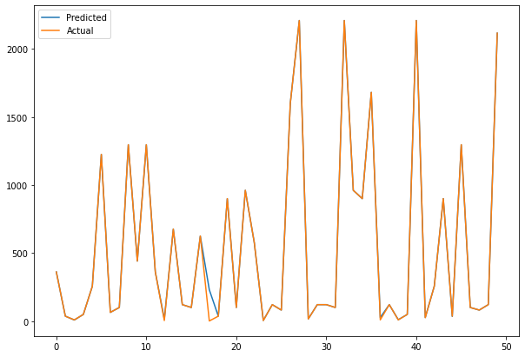
Random Forest
RANDOM FOREST MODEL SHOWING GOOD ACCURACY , THAT WHY TRAINING SCORE AND TESTING SCORE SHOWING MORE THAN 99% ACCURACY.
train_Score0.9988299571299131 test_score0.9910625763066059

Slide 22
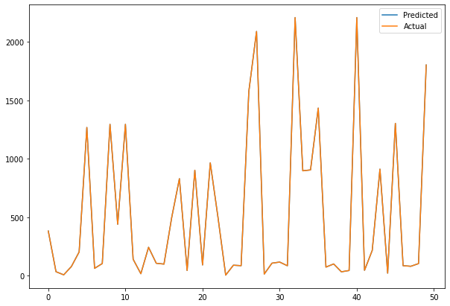
Random Forest with hyperparameteric tuning
RANDOM FOREST WITH HYPERPARAMETRIC TUNING SHOWING GOOD ACCURACY , THAT WHY TRAINING SCORE AND TESTING SCORE SHOWING MORE THAN 95%.
Training score: 0.96 ,Test score: 0.95

Slide 23
.
CONCLUSION:- XG BOOST WITH HYPERPARAMETRIC TUNING GIVE US 100% TRAINING ACCURACY AND 99% TESTING SCORE AND RANDOM FOREST GIVING 99% TRAINING SCORE AND 99% TESTING SCORE INCLUDING LINEAR REGRESSION, LASSO REGRESSION, RIDGE REGRESSION, DECISION TREE, AND RANDOM FOREST. WHEREAS, LINEAR REGRESSION, LASSO AND RIDGE ARE NOT FITTING WELL INTO THE DATA POINTS

Slide 24
THANKS YOU

